Slide 1
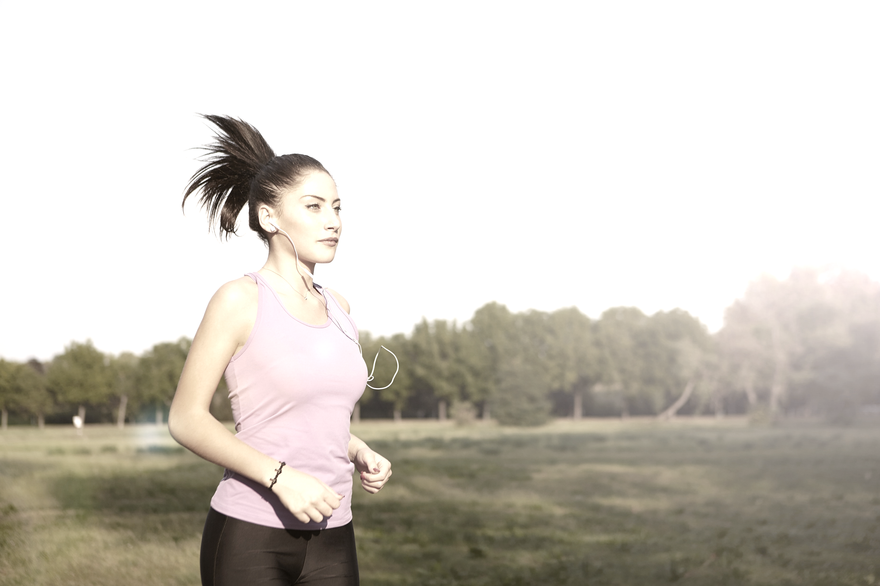




Therapieform
CBT-M
CBT-E
Face-to-face
Setting
Online

